Slide 1



Inland Empire Nonprofit Loan Fund
In-Person Information Session
January 2026

Slide 2
Agenda for Today’s Meeting
Introductions
Debt 101
Loan Program Overview
Fund Application Process & Timeline
Fund Survey & Application Support
Questions?

Slide 3
Introductions

Slide 4
Nonprofit Finance Fund (NFF)
Nonprofit Finance Fund is a Community Development Financial Institution (CDFI) that gives nonprofits access to financing and resources to support thriving communities.
Investor
Financial Educator
Trusted Partner
Advocate

Slide 5
Inland Empire Community Foundation- Fund Administrator

Slide 6
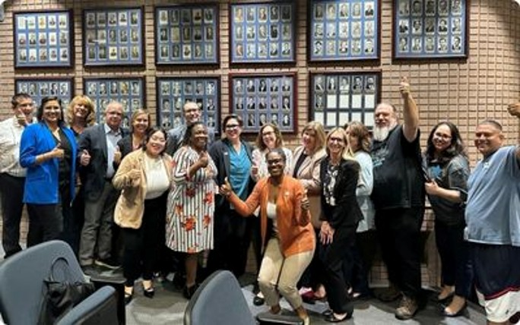
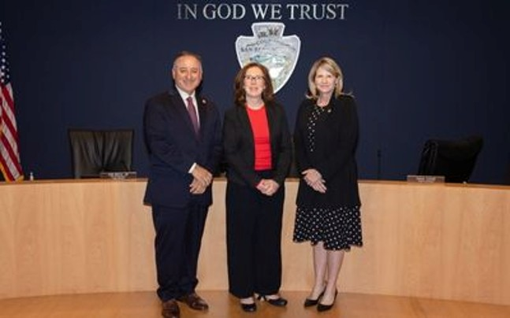
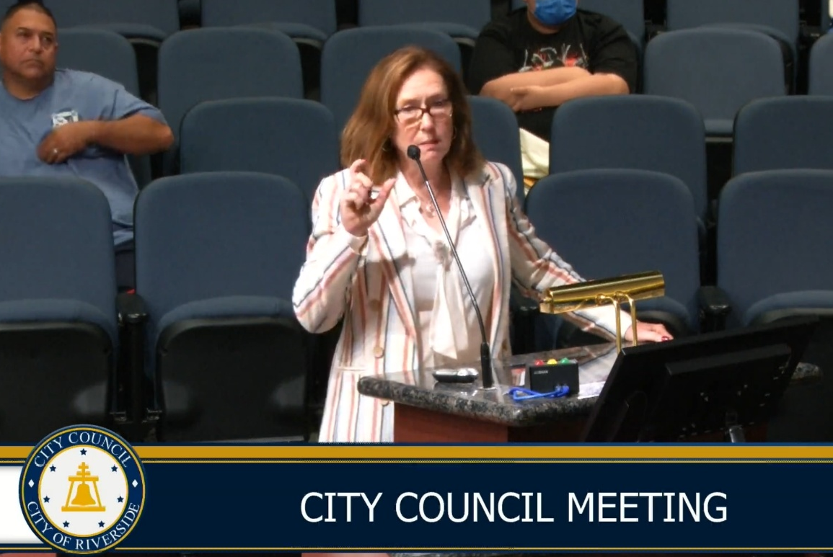

INLAND EMPIRE NONPROFIT LOAN FUND
A first-of-its-kind regional investment: IECF created this fund with the City of Riverside, San Bernardino County, and the Nonprofit Finance Fund to strengthen the nonprofit backbone of the Inland Empire.
Driven by nonprofit voices: Local nonprofits have long advocated for a resource like this—this fund is a direct response to what they said they needed.
Fixing a long-standing gap: Many IE community-based organizations can’t access traditional financing. This fund finally fills that gap.
Thank you to our partners!

Slide 7
City of Riverside: Fund Investor and Loan Approval

Slide 8

Nonprofit Resiliency Fund
Authorized by the Riverside City Council on March 12, 2024.
A $2.8 million municipal investment to:
Expand Nonprofit service reach and capacity in the city;
Allow access to larger sources of funding for facility improvements and innovation;
Provide available and flexible financing to a “hard to lend” clientele; and
Attract other sources of capital to leverage the City’s initial investment.

Slide 9
San Bernardino County: Fund Investor and Loan Approval

Slide 10
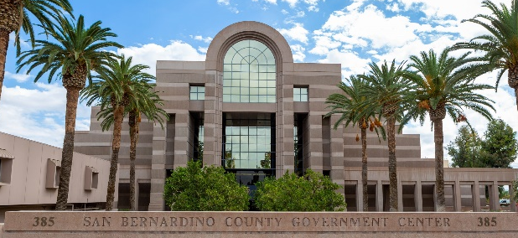
San Bernardino County
REVOLVING LOAN FUND
$3M approved by Board of Supervisors on April 29, 2025
Support nonprofit organizations that serve vulnerable populations such as (but not limited to):
Seniors
Children ages 0-5
Foster children/youth
The unhoused
Those living in low-income communities
Enhance public health and safety, and address the social needs of San Bernardino County residents

Slide 11
Debt 101
Why Nonprofits Borrow Money
How to Know if Debt is Right for a Nonprofit

Slide 12
Debt 101: Why Nonprofits Borrow
Operating Support – Financing to Manage Cash Flow
Timing gap between service delivery and reimbursement
Seasonal working capital needs
Financing an Asset
Facility acquisition or renovation
Equipment, technology purchases
Planned Growth or Expansion
Need for up front cash to start or expand a program
Debt Consolidation
Can be helpful as part of a turnaround plan
Requires considerable analysis and planning

Slide 13
Debt 101: How to Decide if Debt is the Right Solution for your Nonprofit
When Debt is a Good Idea
Reasonable certainty of sufficient revenue to cover BOTH normal operating costs and required debt service.
Clear repayment plan and an understanding of the total cost, including interest and fees.
Borrowing to even out cash flow
Investment in an appreciating asset
When Debt is Not the Answer
Significant gap in the operating budget or capital budget
Borrowing to cover payroll and other recurring expenses

Slide 14
Loan Program Overview
Types of Loans
Eligibility Criteria

Slide 15
Types of Loans Available
Working Capital Loans To even out cash flow (e.g. manage reimbursement delays w/government contracts)
Real Estate Loans To purchase or renovate facilities essential to service delivery
Bridge Loans Short-term loan w/confirmed source of repayment (e.g. capital campaign pledges)
Facility Improvement Loans Tenant improvements, Energy Efficiency (solar, HVAC, roof)

Slide 16
Loan Terms & Eligibility Criteria: San Bernardino County
Loan Terms
Maximum Loan Amount up to $400,000
Minimum Loan Amount $100,000
1-5 years to repay, depending on loan type
Affordable Interest Rate: SOFR + 1.25% (5.18% as of Dec. 2025)
Eligibility Criteria
501c3 nonprofits
Minimum Revenue Requirement $500,000
Unrestricted operating surplus in 2 of the last 3 years
Project or Services must benefit San Bernardino County residents

Slide 17
Loan Terms & Eligibility Criteria: City of Riverside
Loan Terms
Maximum Loan Amount up to $400,000
Minimum Loan Amount $100,000
1-5 years to repay, depending on loan type
Affordable Interest Rate: SOFR + 1.25%
Closing fee – 1.0% of the loan amount
Eligibility Criteria
501c3 nonprofits
Minimum Revenue Requirement $500,000
Unrestricted operating surplus in 2 of the last 3 years
Project or Services must benefit City of Riverside residents

Slide 18
Fund Application Process & Timeline
Application Process
Applicant Survey & Application Link
Document Collection

Slide 19
Loan Fund Application Process
Submit Intake Survey
NFF will reach out directly to confirm intake form has been submitted
Unique loan application link sent to applicant
Submit Loan Application
Loan Review and Approve/Deny/ Approve with conditions
Applicant Notified

Slide 20
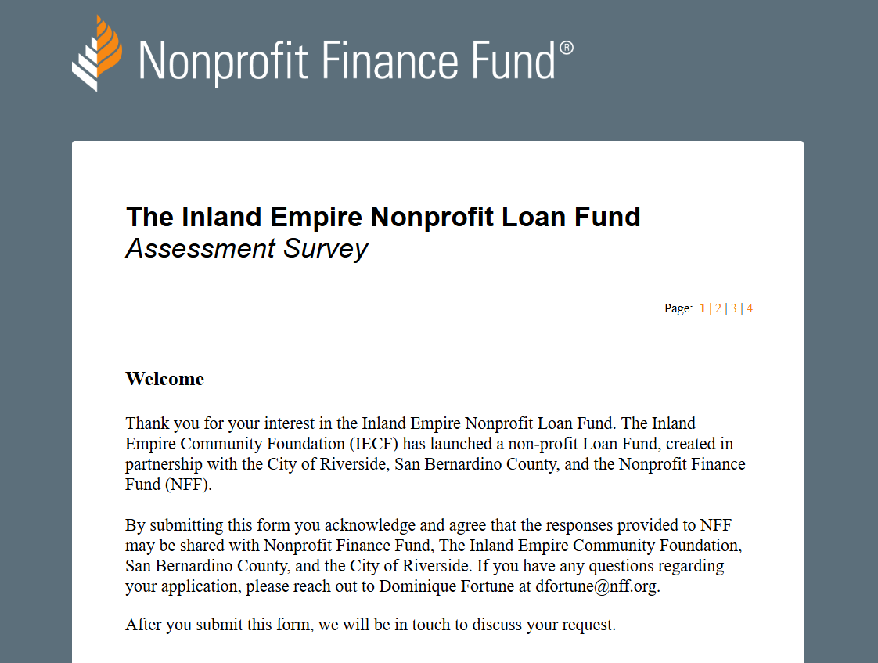
Loan Fund Online Borrower Assessment Survey & Online Application Links
Online Borrower Survey Form Landing Page
Links found on partner webpages.

Slide 21
Document Collection
A list of documents collected during the due diligence collection period.
Financial/Operations Documents
Board approved budget for the current fiscal year
Internally prepared financial statements for current and prior year
Audited financial statements
Schedule of Government Contracts and/or major Funders
Annual operating projections
12-month cash flow forecast
Corporate/ Governance Documents
Articles of Incorporations
By-laws
501c3 determination letter
Description of Programs
Client Data
Management and Board Bios
Organizational Chart

Slide 22
Fund Application Timeline- Important Dates to Know
1 Dec. 2025
Fund Launch Date- Application Window Opens!
Dec 2025 /Jan. 2026
Information Session Webinar 12/10
31 Jan. 2026
Application Window Closes
1 Feb. 2026
Loan Application Review by Loan Committee
Mar. 2026
Mid- Late March 2026: Applicants informed of loan Approval/Denial by Loan Committee
April 2026
Expected Loan Funding
In-Person Information Sessions 1/13 and 1/14/26 (Location TBD)

Slide 23
Questions about the Loan Fund ?
Contact Information
Online Survey or Application Issues: assessment@nff.org
All other questions: Dominique Fortune dfortune@nff.org

